Slide 1


Slide 2


Reseller Sales Analysis Based on AdventureWorks 2017
Tianshuai Lu, MEng
Xiaoye Wang, MEng
Chonghao, Wang, MEng
Pengshuo Liu, MEng
Advanced Database
Data Analytics Foundations

Slide 3
Outline
Business Scenario
Database Design
Multidimensional Model
ETL with T-SQL
ETL with SSIS
SSAS
Data Mining
Advanced Database

Slide 4
Adventure Works
An American cycles company.
Resellers and individual customers.
Located in North American, European and Asian.
Track sales to all resellers.
Product, promotion, reseller, location, sales person
Broaden its reseller market share.
Forecast selling prices and shipping expenses.
Optimize new product pricing strategies.
Advanced Database
Notes:
Adventure Works is an American cycles company that sells bikes, accessories, clothing and components, etc .
The primary distribution channels for Adventure Works are through the retail stores of their resellers and online website to individual customers.
This company mainly provide products to North American, European and Asian commercial markets.
In this project, we would like to track sales to all resellers. From Product, promotion, reseller, location, sales person these dimensions to build our data warehouse.
In this business scenario, adventure works also want to broaden it’s reseller market share.
We would like to do some data analysis to contribute to that.
Like Forecast selling prices and shipping expenses and Optimize new product pricing strategies.

Slide 5
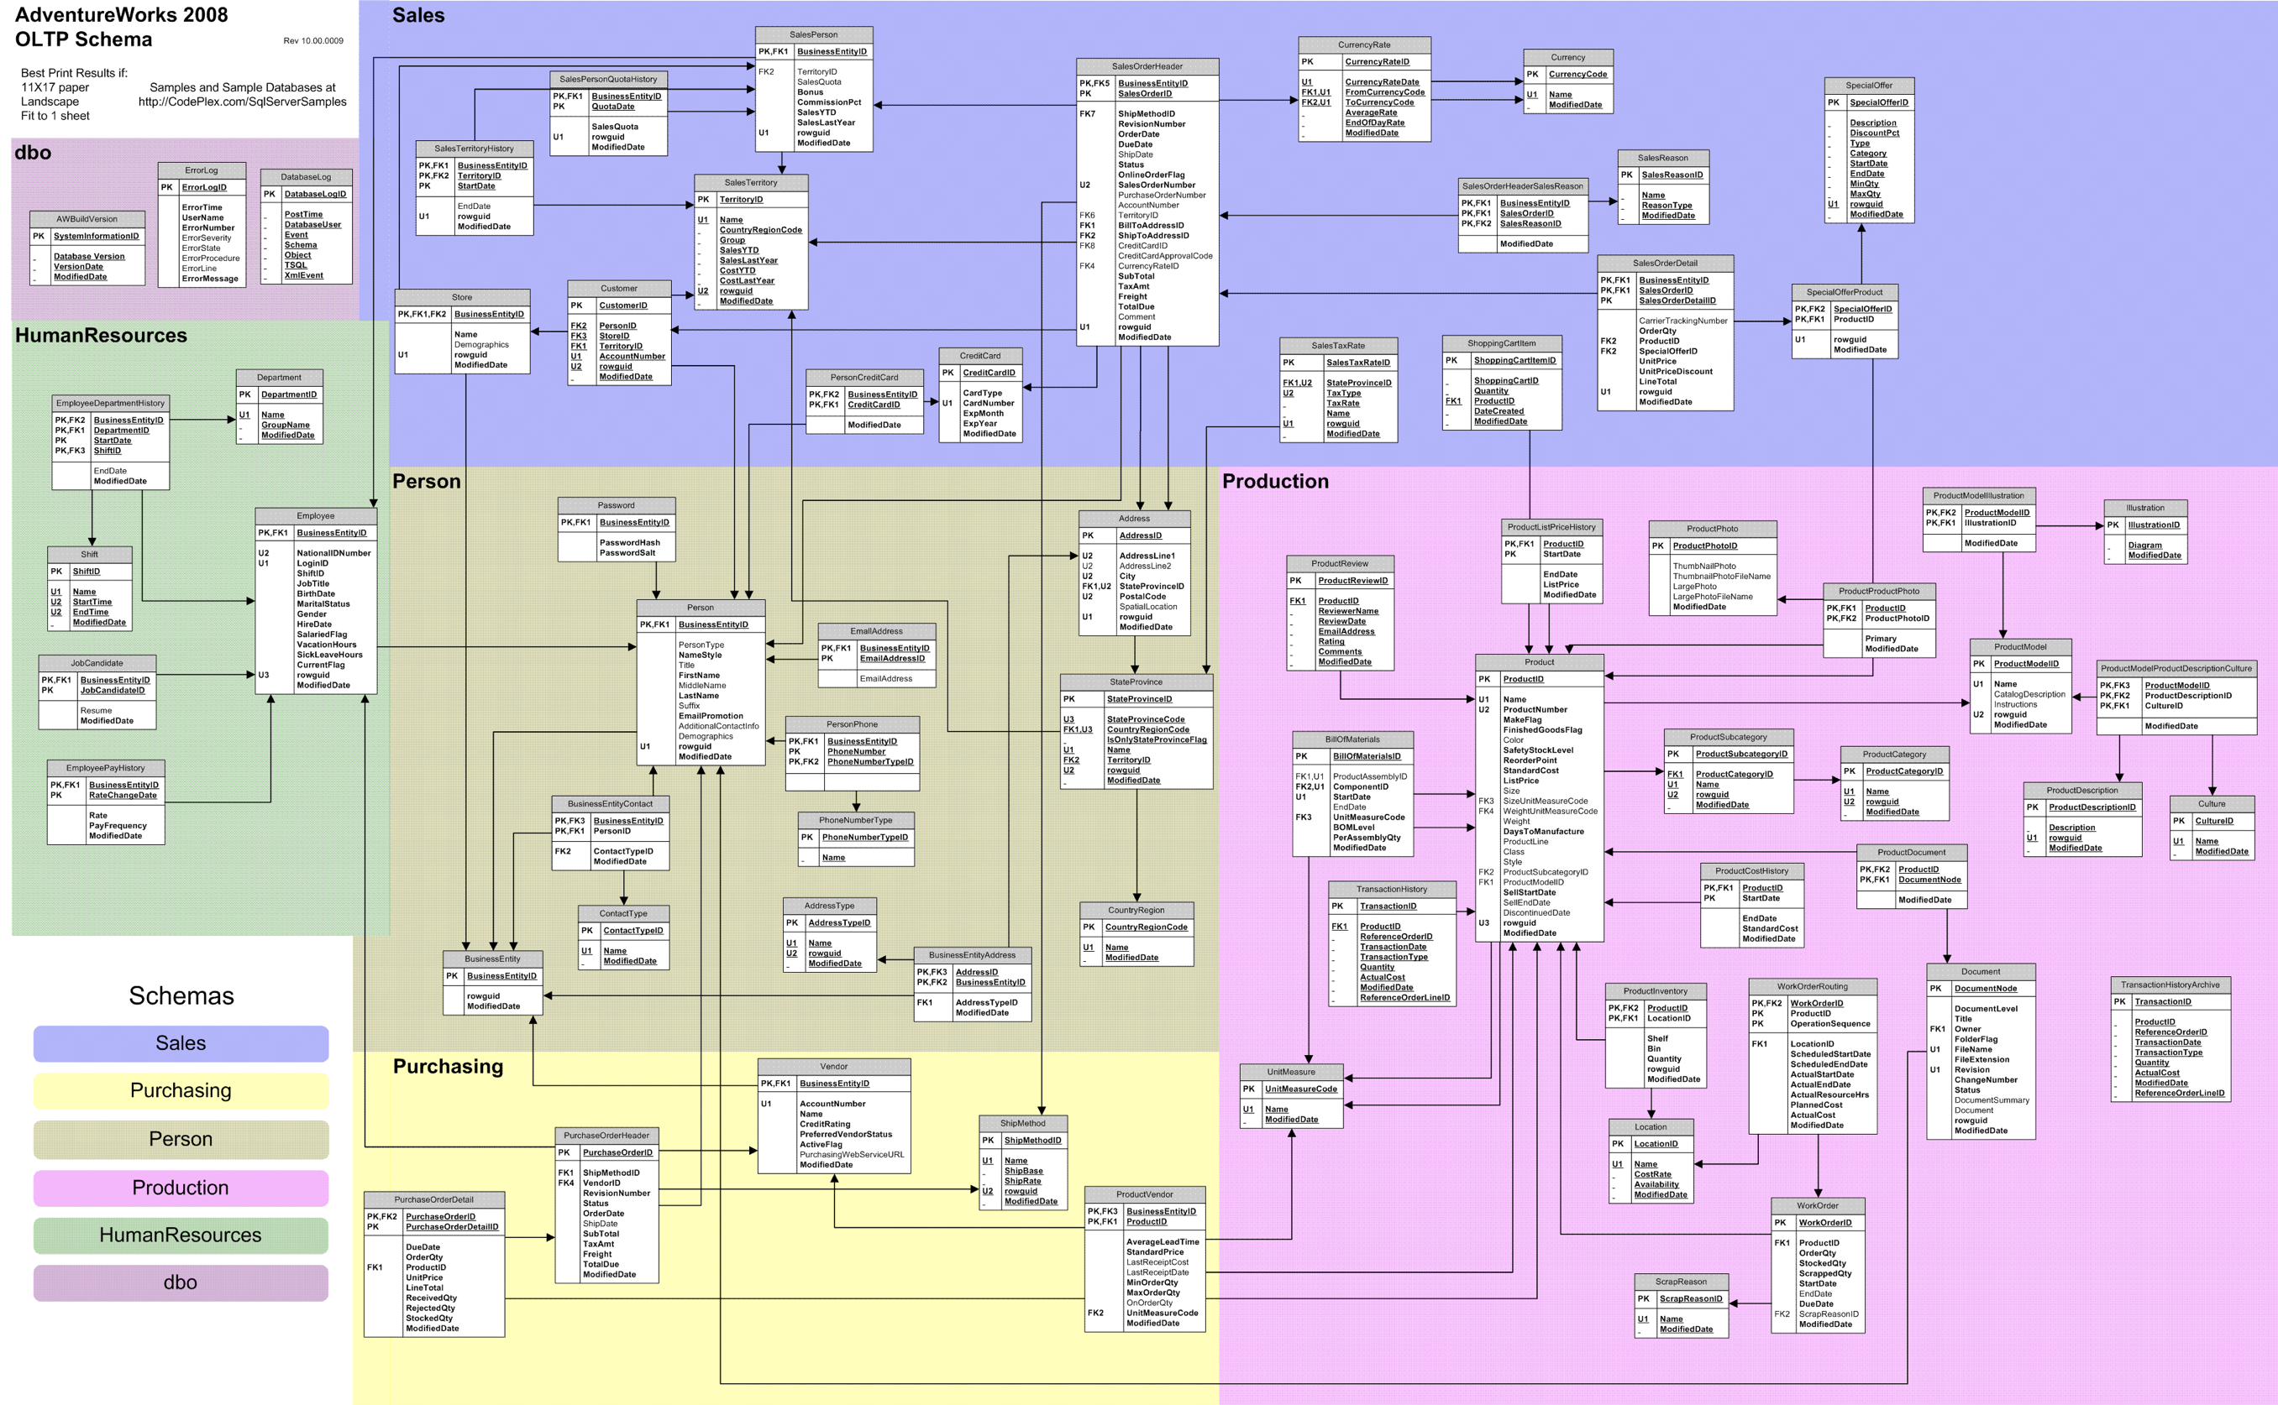
AdventureWorks2017
Advanced Database
Notes:
Let’s look at our data souce, adventure works 2017.
As you may concern, this database has well developed 3rd normal form tables and already built data warehouse,
our work start from here but not same as here
This database has more than 60 tables in 5 schemas, that’s too many for us
We need to extract data and tables that we want to use

Slide 6
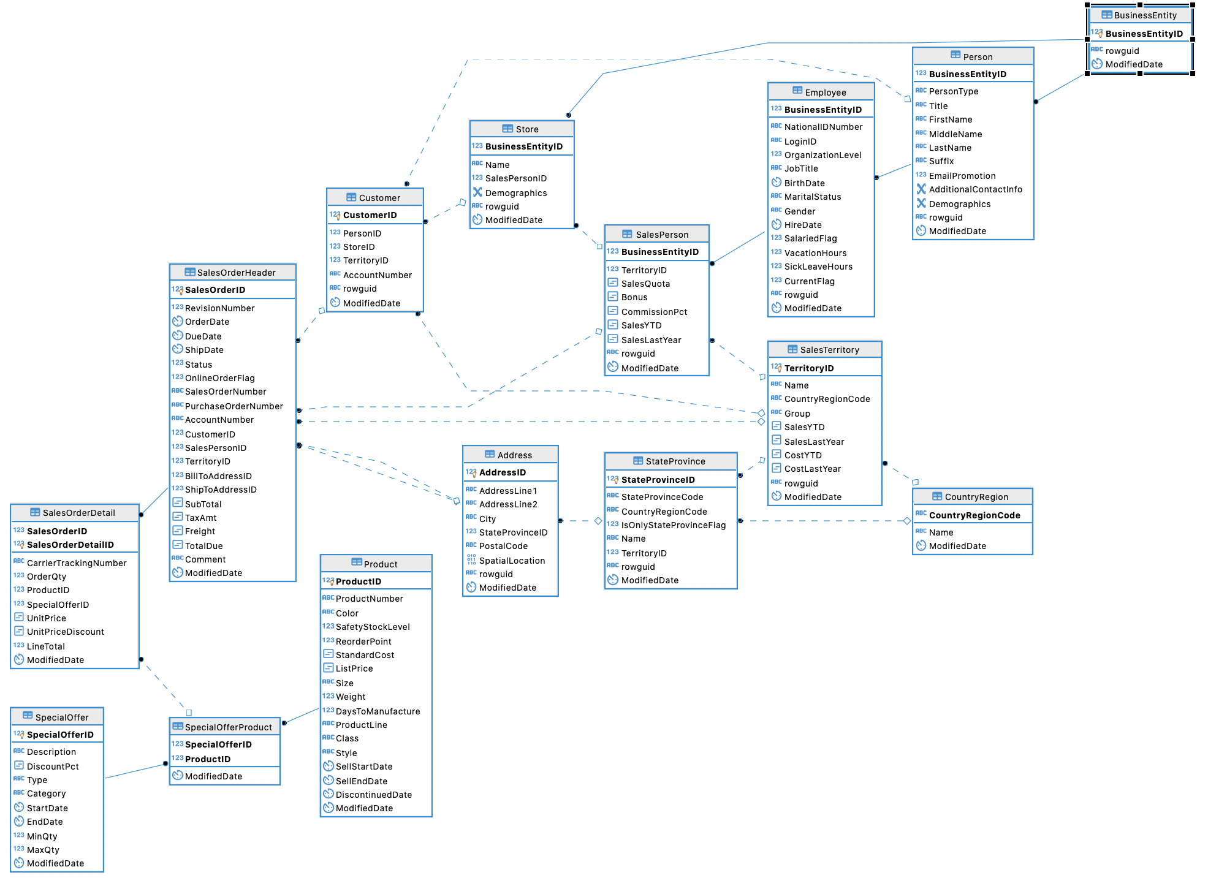
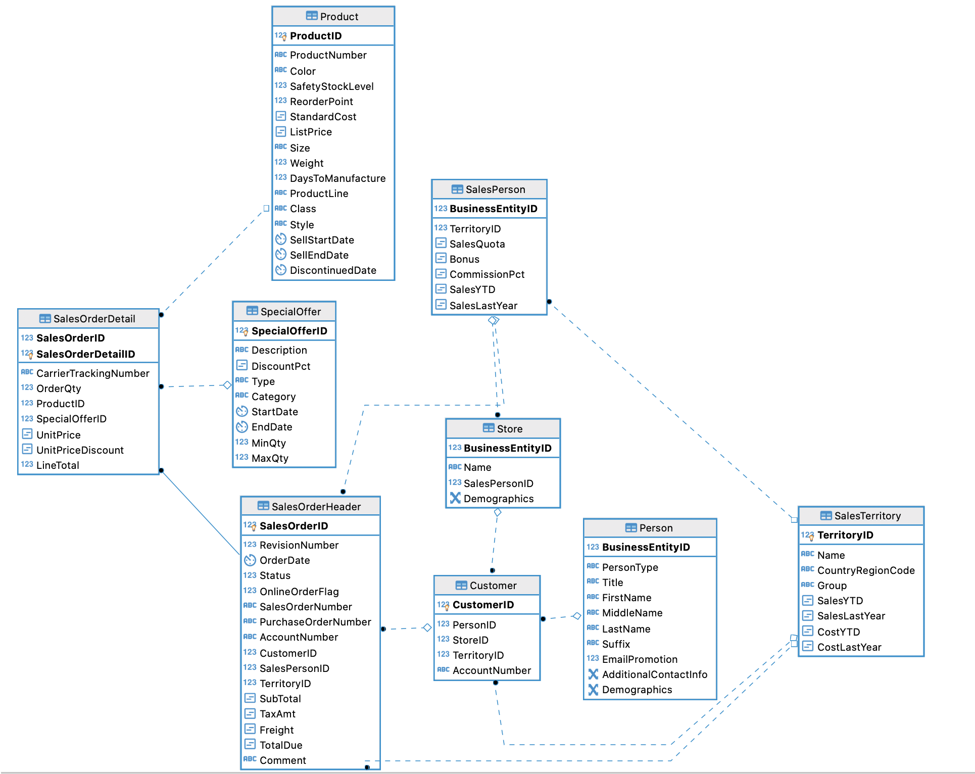
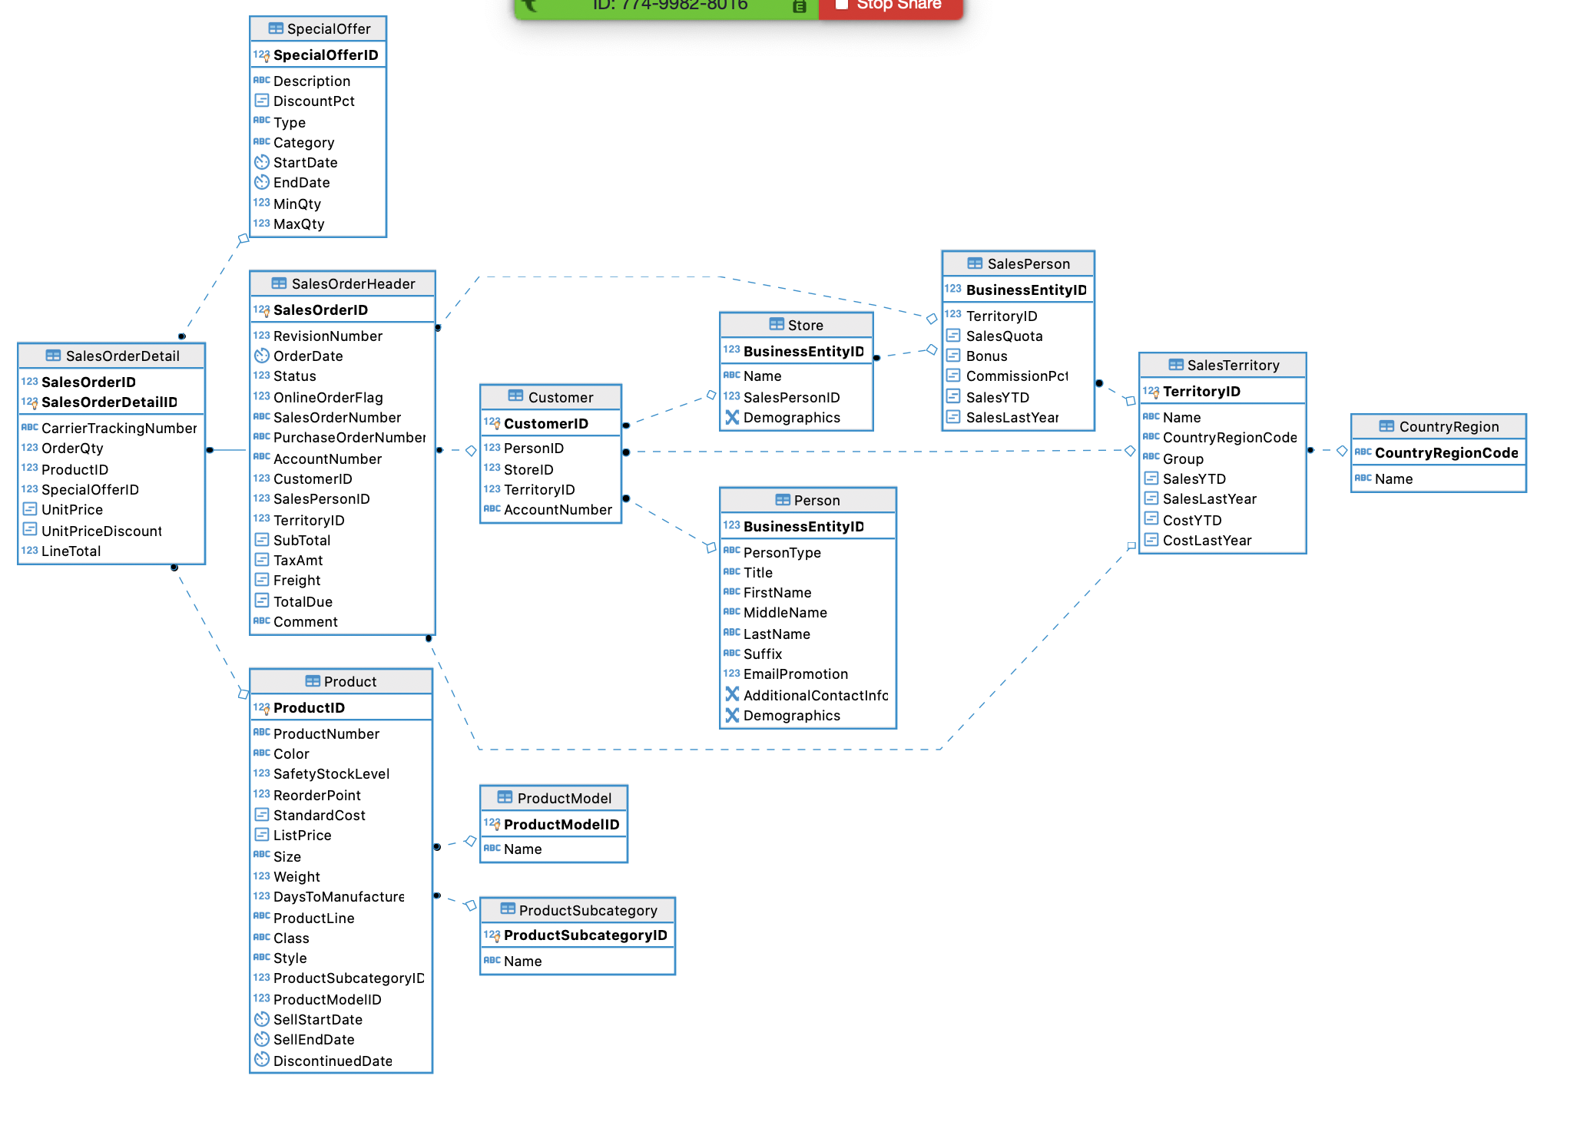
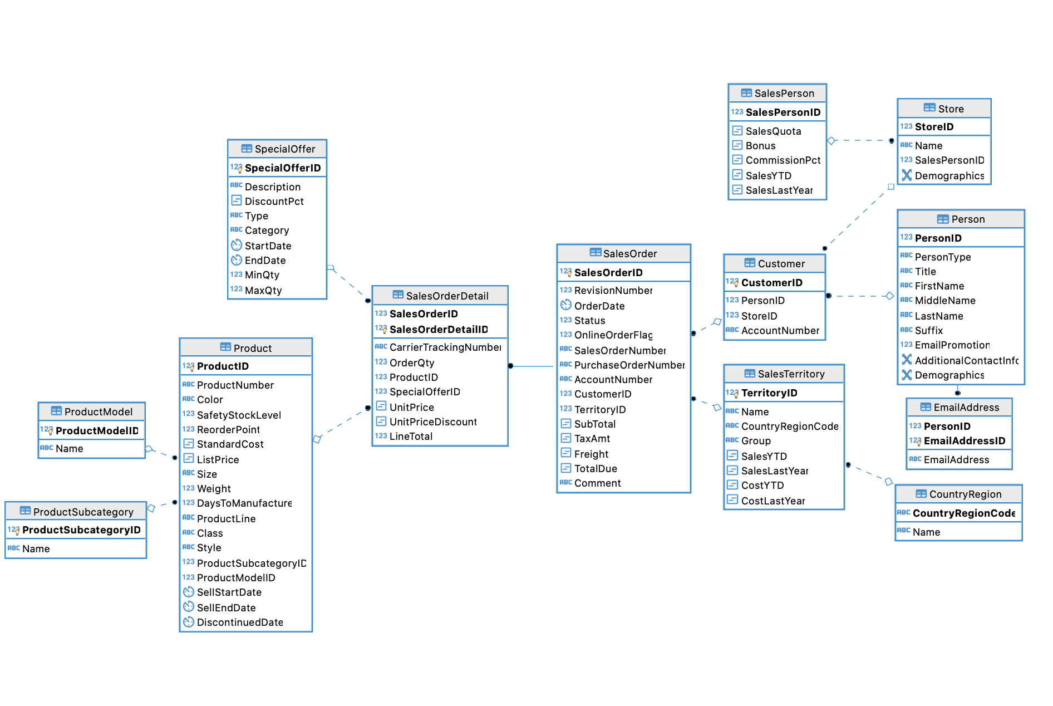
Advanced Database
Notes:
We take a lot of efforts to extract data and tables from data source and transform them into 3rd NF
Here are some design steps that we had
After extracting, deleting, merging, reorganizing tables and relationships, we finally got our own db.

Slide 7
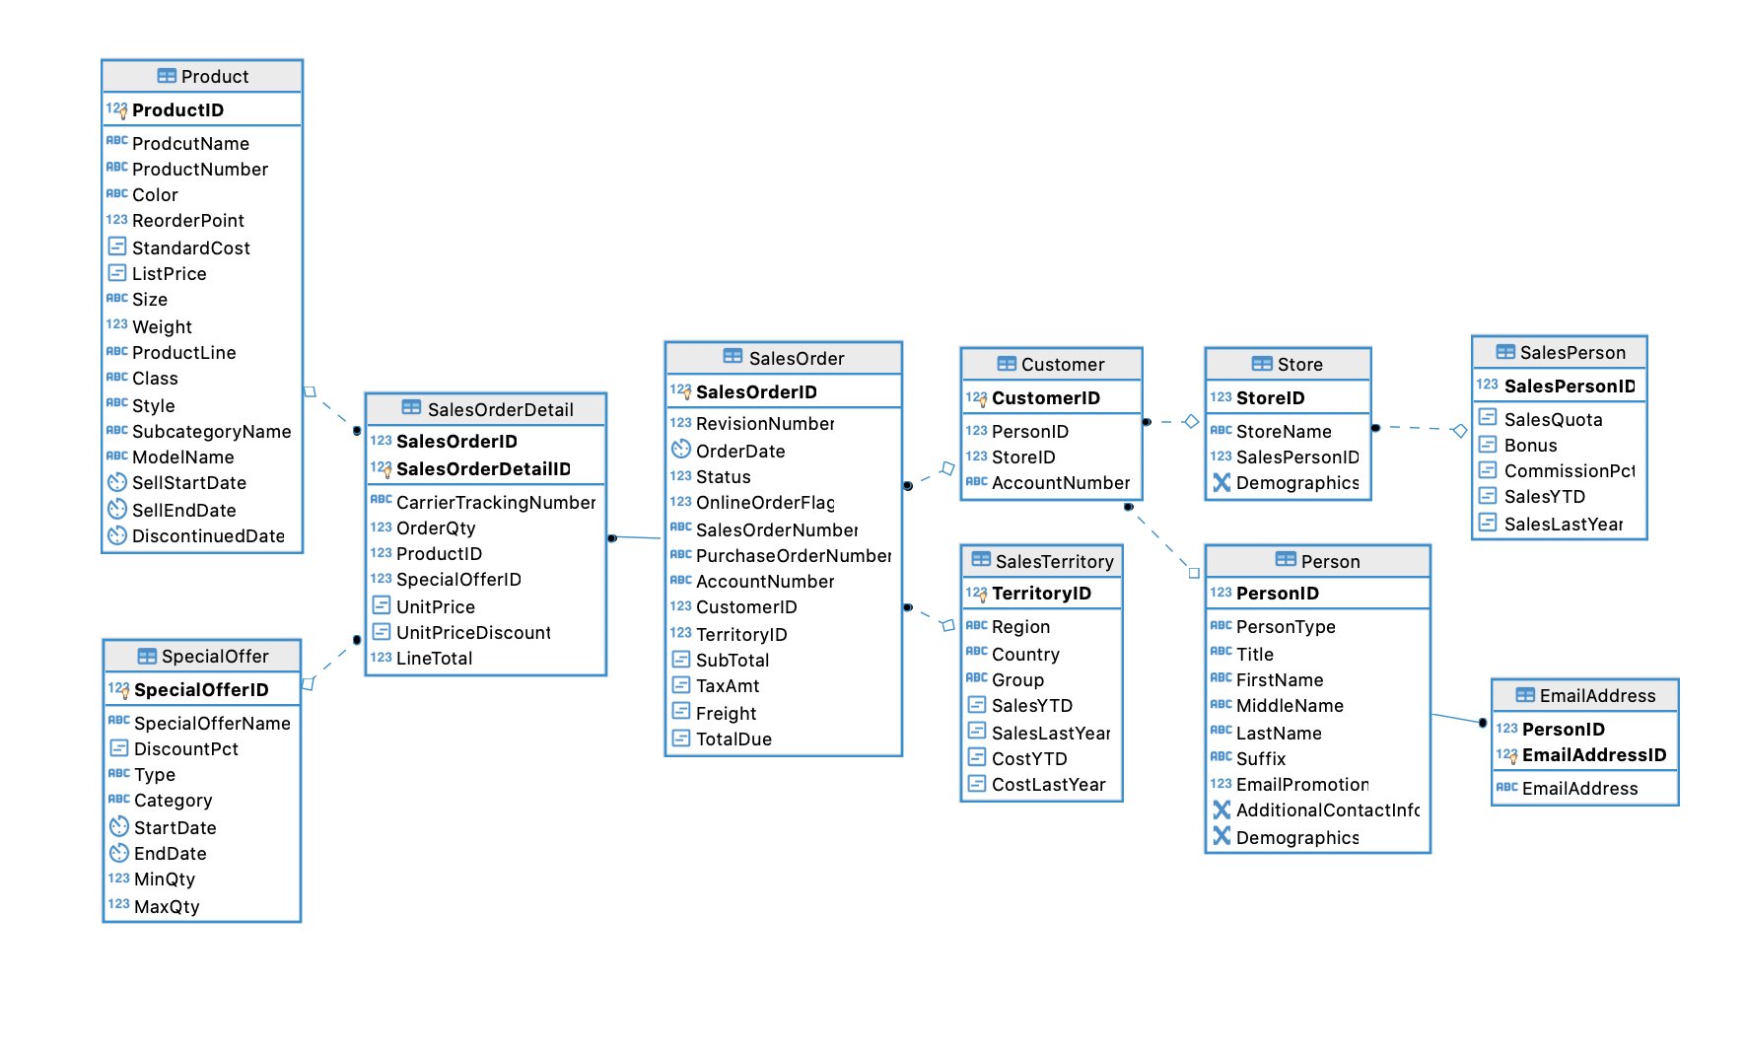
Advanced Database
Notes:
Our adventure works 2021 database contains 10 tables, as you can see,
From product, discount, orders to customers, resellers, sales person and location.
Next, we will talk about data warehouse design.

Slide 8
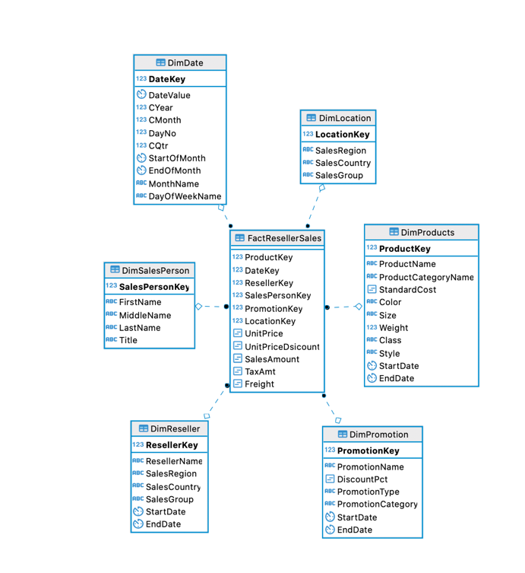
Multidimensional Model
Advanced Database

Slide 9
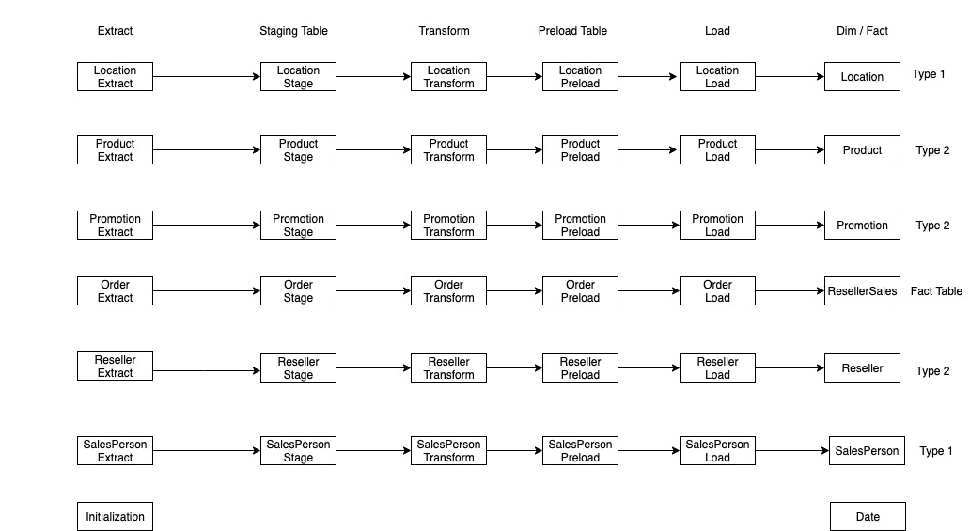
ETL with T-SQL
Advanced Database

Slide 10
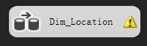
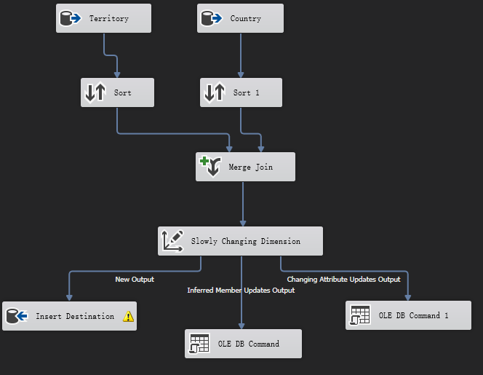
ETL with SSIS
Advanced Database

Slide 11
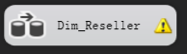
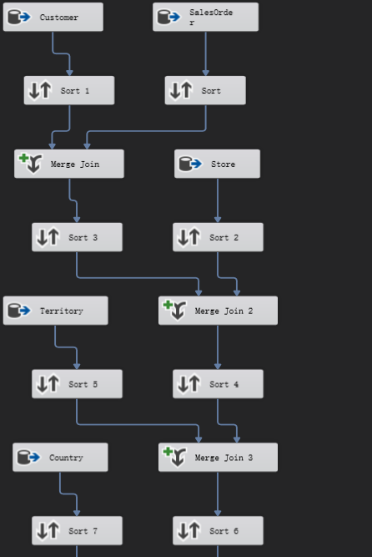
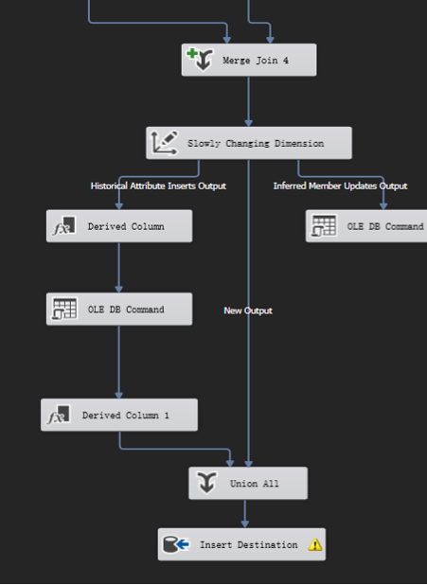
ETL with SSIS
Advanced Database

Slide 12
Business Analysis
Advanced Database

Slide 13
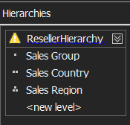
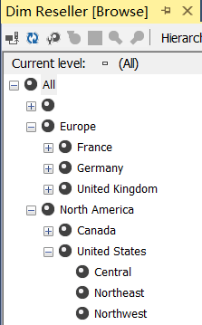
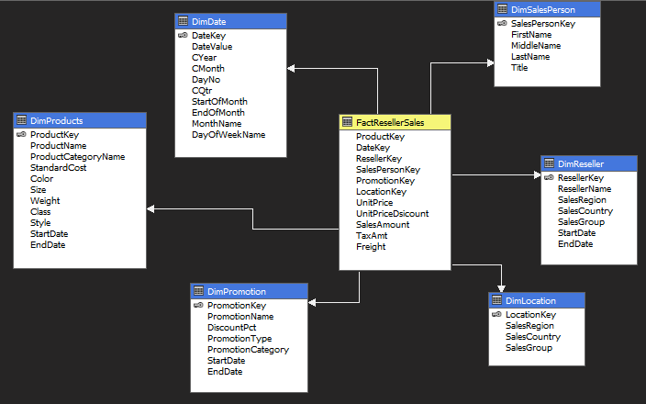
SSAS
Advanced Database

Slide 14
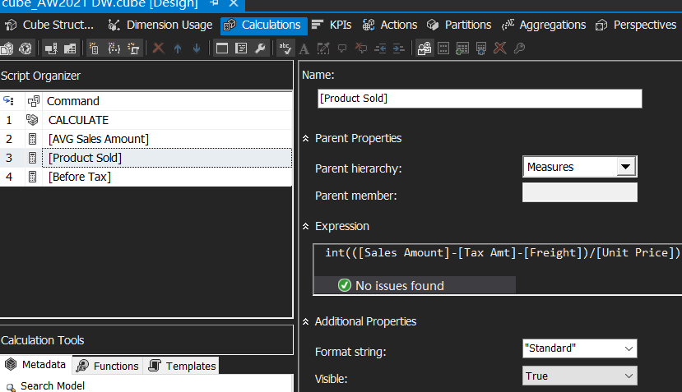
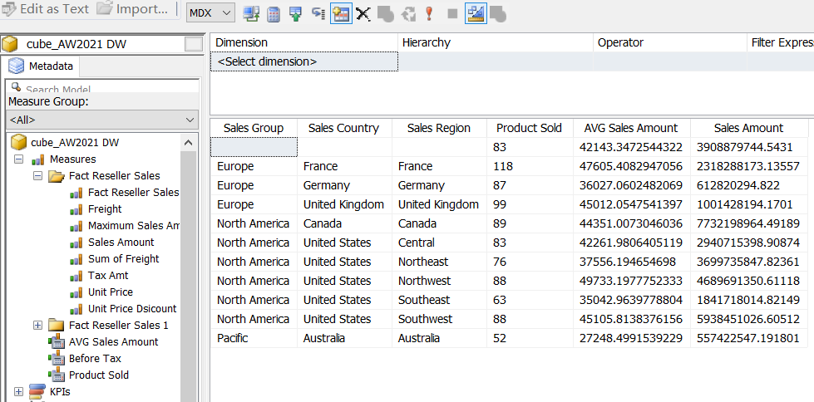
SSAS
Advanced Database

Slide 15
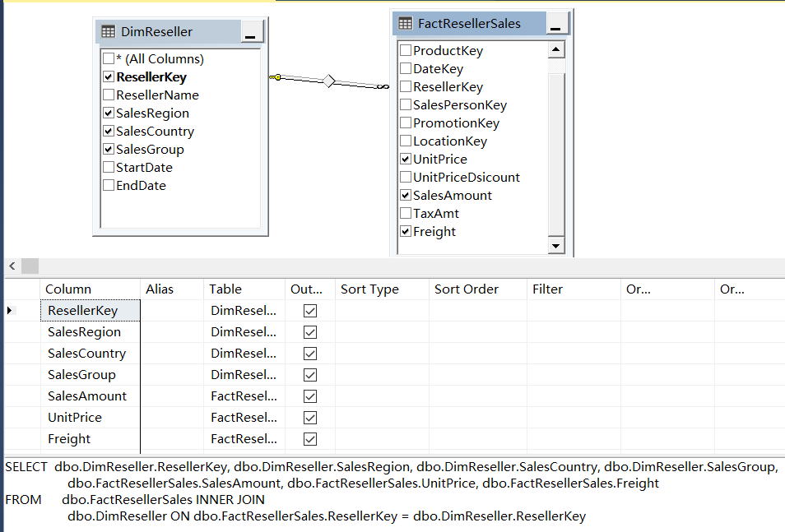
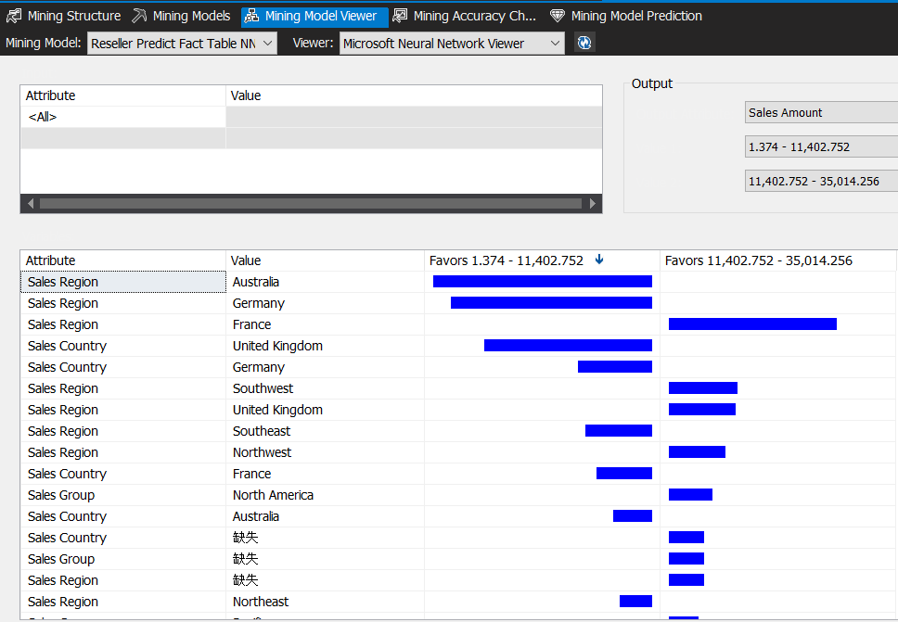
Data Mining – Predict Sales Amount
Advanced Database

Slide 16
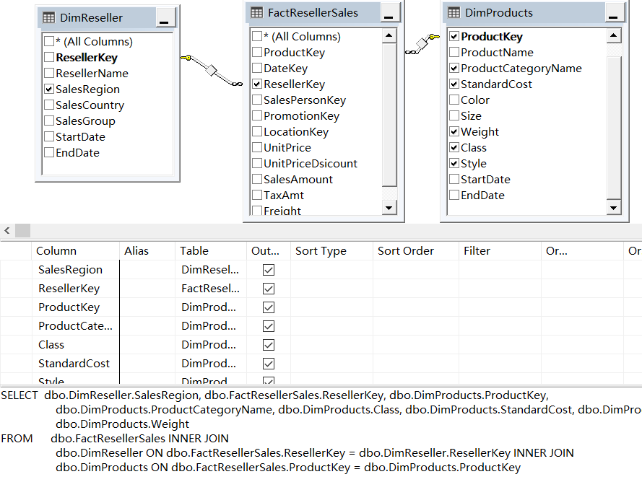
Data Mining – Predict Reseller Location
Advanced Database

Slide 17
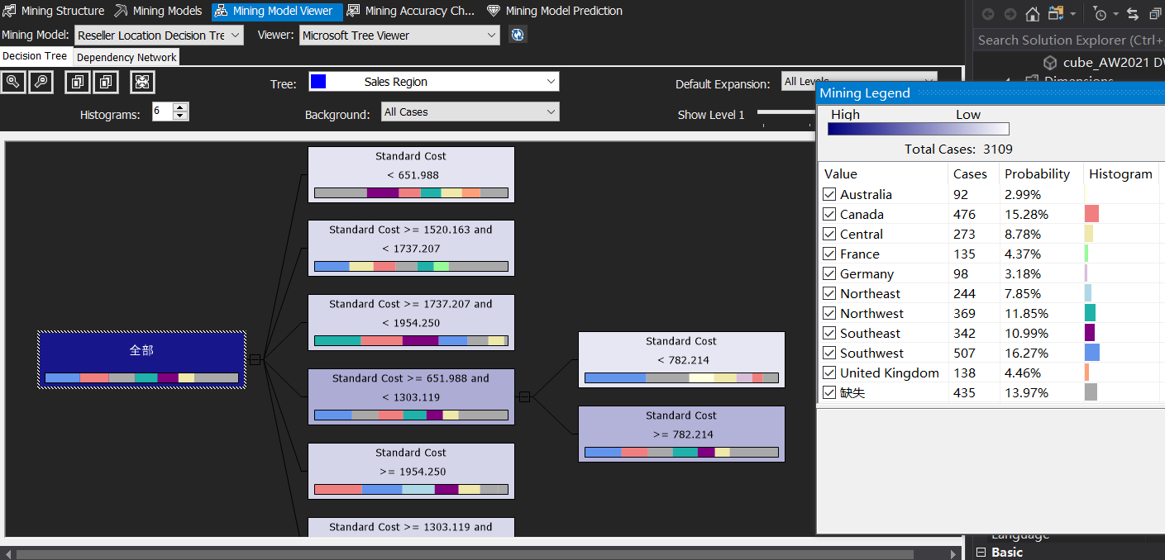
Data Mining – Predict Reseller Location
Advanced Database

Slide 18
Thanks For Watching
Advanced Database

Slide 19
Notes:
Patrick Adjei

